Slide 1
Social Networking System
K. Venkata Ramana
M. Rama krishna
E.Akhil

Slide 2
Problem Statement
Due to rapid development of social networking people are increasingly using social media applications for communication, in order to stand this trend many mnc’s are developing many chat applications some them stealing users data.

Slide 3
Introduction
In today's digital age, communication is at the heart of our interactions. Our chat application aims to revolutionize the way people connect by providing a platform that combines user-friendly design, real-time messaging, and robust security. With a focus on enhancing both convenience and privacy, our application seeks to create a seamless and enjoyable communication experience for users across the globe. Whether sharing multimedia, staying in touch across devices, or ensuring data protection, our chat application is designed to empower users with a reliable and secure means of connecting with their loved ones and colleagues.

Slide 4
Existing system
Presently there were many chat applications in the present society which have many vulnerabilities and even we seen in the past, there are some organizations which leaked millions of users data in the Dark web, so privacy is became a major concern.

Slide 5
Proposed system
To overcome this privacy concern we implemented a chat application in where users can freely access it without any subscriptions and since we are not storing any users personal chat, we can remove there privacy bias.
Since it is in beginning stage we provide only the basic chat feature but in future we will provide all the specifications just like snapchat and whatsapp.

Slide 6
Software and Hardware Requirements
Software requirements
Hardware requirements
Java latest version
Eclipse EE ide
Visual studio code
MYSQL workbench
Any browser
SSD with minimum 256gb storage
4gb RAM
I3-11 gen processor
Windows 10 operating system

Slide 7
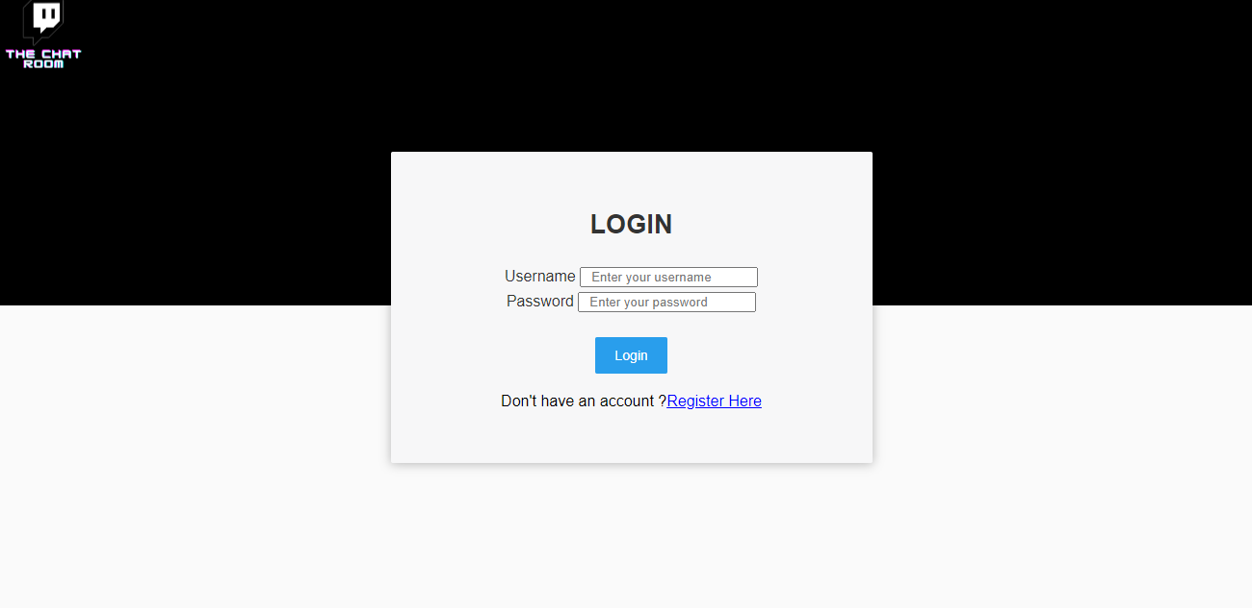
Outputs

Slide 8
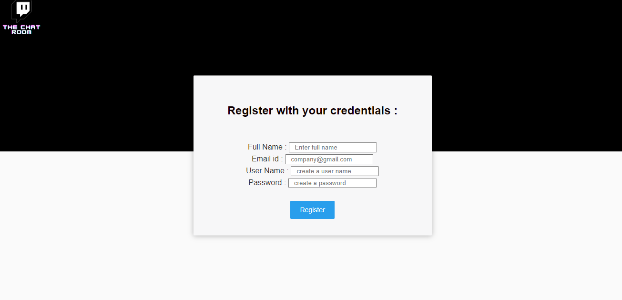

Slide 9
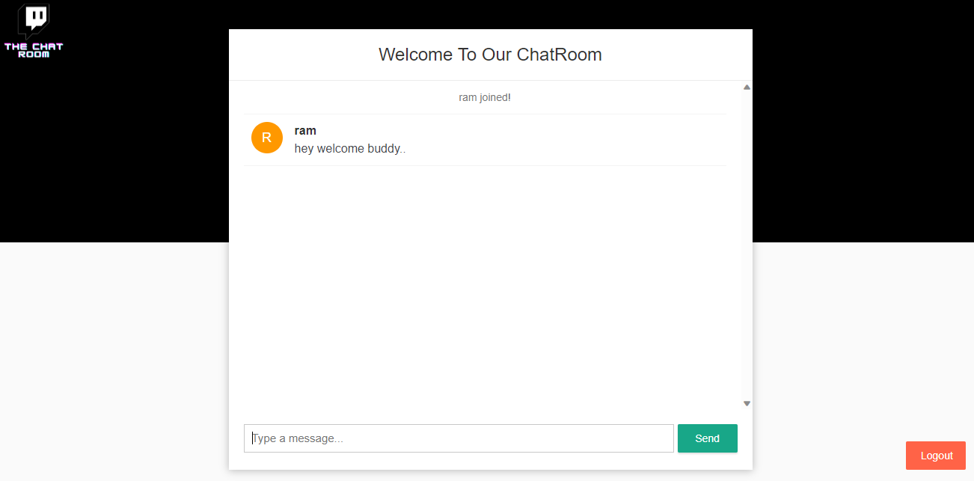

Slide 10
Conclusion
In conclusion, chat applications have revolutionized how we connect. Existing systems offer a range of features, balancing user experience and security. Looking ahead, innovation will bring AI-powered interactions, stronger security, and seamless integration. This evolution ensures that communication remains efficient, personalized, and secure, promising an exciting future of enhanced connections.

